Slide 1
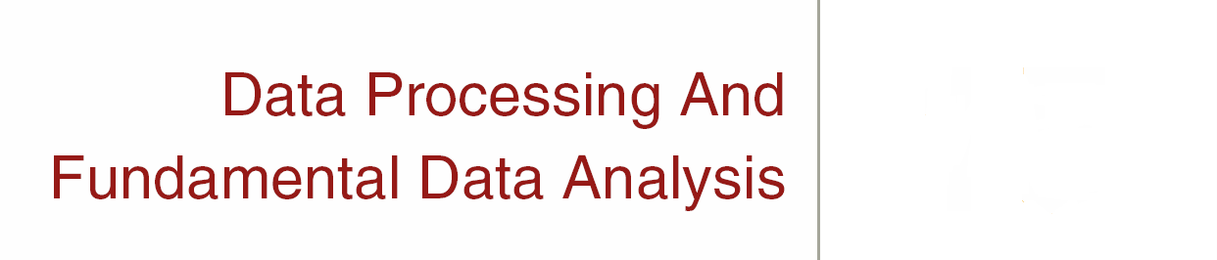

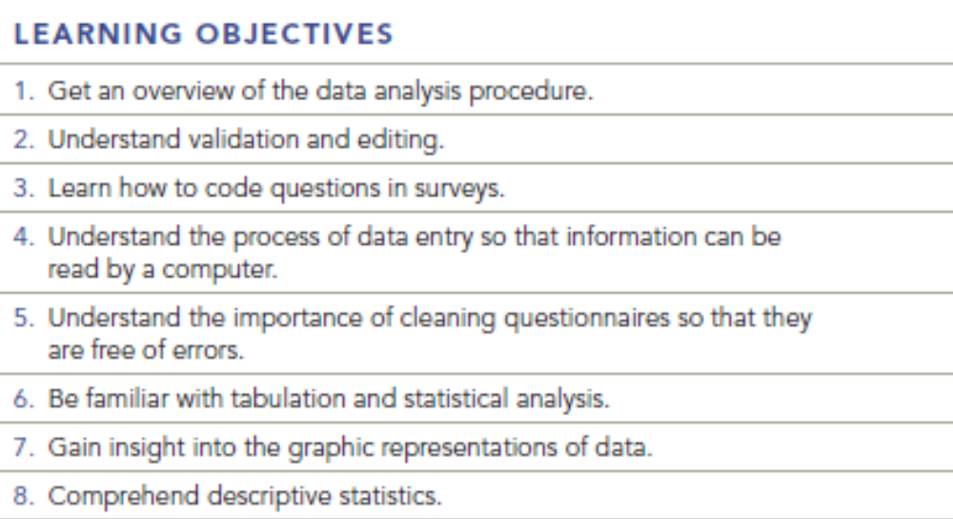
Chapter Fifteen Q & A
15-1

Slide 2
Question
Assume that Sally Smith, an interviewer, completed 50 questionnaires. Ten of the questionnaires were validated by calling the respondents and asking them one opinion question and two demographic questions over again. One respondent claimed that his age category was 30-40, when the age category marked on the questionnaire was 20-30. On another questionnaire, in response to the question, “What is the most important problem facing our city government?” the interviewer had written, “The city council is too eager to raise taxes.” When the interview was validated, the respondent said, “The city tax rate was too high.” As a valuator would you assume that these were honest mistakes and accept the entire lot of 50 interviews as valid? If not, what would you do?

Slide 3
Answer
The error on the first questionnaire may have been a judgment call on the part of the interviewer or it may have simply been a missed stroke of the pencil or computer. The second mistake, which is a completely different answer with similar content, gives cause for more concern. Check another ten questionnaires to see if more mistakes crop up. It may be that all the questionnaires should be validated. Sally may need more training.

Slide 4
Question
Give an example of a skip pattern on a questionnaire. Why is it important to always follow the skip patterns correctly?

Slide 5
Answer
1. Have you eaten at a fast food restaurant in the last two weeks? Yes No
If yes, skip to question 2. If no, skip to question 9.
If the skip pattern is not followed correctly, then unnecessary and inappropriate questions may be asked and error may be introduced in interpreting the respondents’ answers.

Slide 6
Question
It has been said that, to some degree, coding of open-ended questions is an art. Would you agree or disagree? Why? Suppose that after coding a large number of questionnaires, the researcher notices that many responses end up in the “Other” category, what might this imply? What might this imply? What could be done to correct it?

Slide 7
Answer
Coding open-ended questions is part science and part art. When there are clear themes in the data, similarly well-trained coders will produce consistent (reliable) sets of codes. If a lot of responses ended up in the “Other” category, it is possible that the coding categories were not properly selected or explained to the coders or that the categories are not complete. In this case, new coding categories should be created.

Slide 8
Question
It has been said that a cross-tabulation of two variables offers the researcher more insightful information than does a one-way frequency table. Why might this true? Give an example.

Slide 9
Answer
A cross-tabulation between two variables provides the researcher with data that looks at the relationship between two categorical variables. Two one-way frequency tables are interesting, but do not provide the same kind of data.
A one-way table would show that all consumers have about a 50% purchase rate (150 Yeses/300 responses). Cross-tabulation reveals that females have a much higher propensity to purchase than males (90/150 versus 60/150, respectively).

Slide 10
Question
Calculate the mean, median, mode, and standard deviation from the following data set (p 388, Q11)

Slide 11
Answer
 | Whitehill Mall | Northpark Mall | Sampson Mall
Mean | 8.0 | 7.9 | 8.6
Median | 7 | 7 | 8
Mode | 4 | 3 | 1
Standard deviation | 5.3 | 6.6 | 6.9

Slide 12
Question
Page 388, Q 12
Enter the following data into an Excel spreadsheet. Include the column headings (Q1, Q2, and Q3), as well as the numeric values. The definitions of the numeric values are provided at the bottom of the table. Use the Pivot Table feature in Excel (found under the Data option) to cross-tabulate the likelihood of purchase (row) by gender (column) and income level (column). What conclusions can you draw about the relationship between gender and likelihood of purchase and that between income and likelihood of purchase?

Slide 13
Question
Student version of SPSS works much better (easier, more intuitive) for this sort of analysis, Enter the data, select Analyze, Descriptive Statistics, and Crosstabs. Click Q1 to the column field and Q2, Q3 to the row field. Click on Finished.

Slide 14
Question
This analytical procedure shows the responses to one question relative to the responses of another question.
a. one-way frequencies
b. cross tabulation
c. t-test
d. z-test
e. none of these

Slide 15
Answer
Ans: B

Slide 16
Question
Which of the following is the most flexible type of graph?
a. line chart
b. bar chart
c. pie chart
d. scatter plot graph
e. All are equally flexible.

Slide 17
Answer
Ans: B

Slide 18
Question
If we conclude that the average weekly amount of soft drink consumption by males and females is about the same, but that the standard deviation among males is greater than that for females, what would this mean?
a. Males and females pretty much agree as to how many soft drinks they consume per week.
b. Males consume more soft drinks per week than females.
c. Even though males and females consume, on average, about the same number of soft drinks, there is more diversity of consumption among males.
d. Females are more health conscious than males.

Slide 19
Answer
Ans: C

Slide 20
Question
If an interviewer did not properly follow skip patterns specified in a questionnaire, the ______________ step in data analysis would reveal the problem.
a. validation
b. editing
c. coding
d. analyzing
e. data cleaning

Slide 21
Answer
Ans: A

